Slide 1

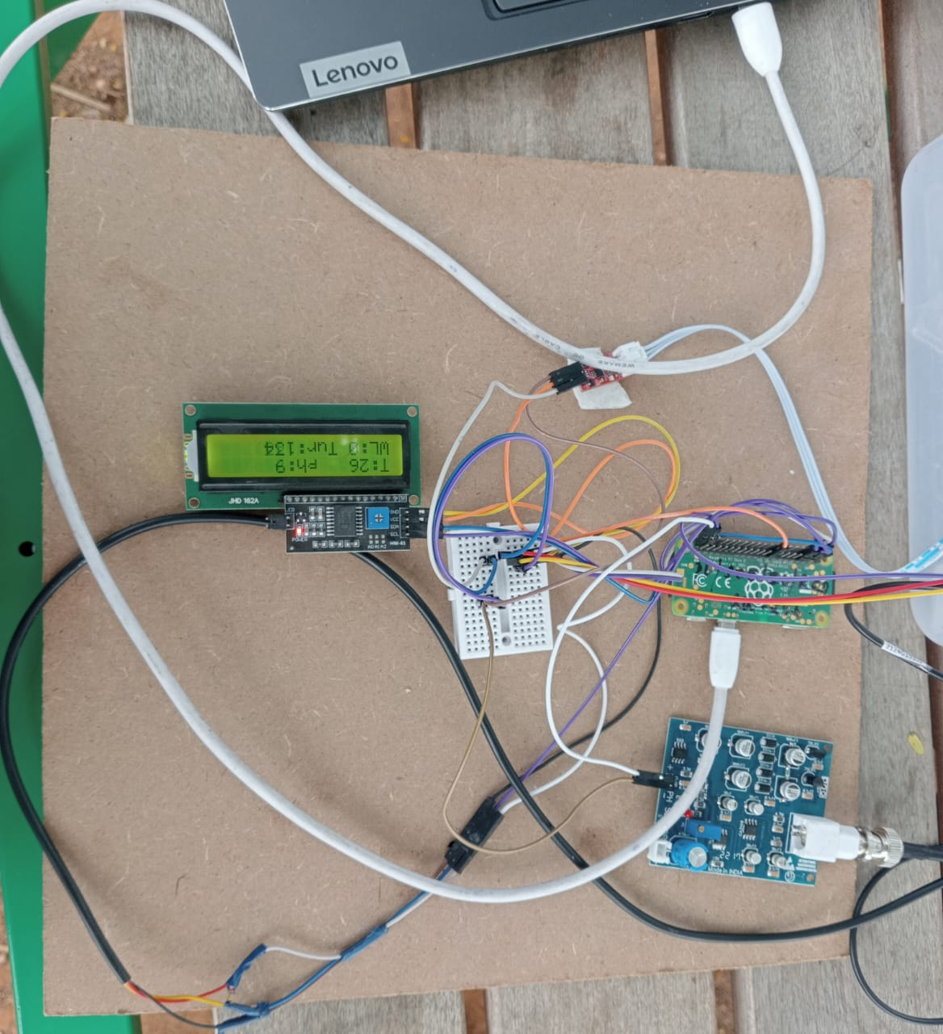





TARUN V 20231CCS0140 CCS
SOE and SOCSE
INNOVATIVE PROJECTS USING RASPBERRY Pi (ECE2011)
WATER QUALITY MONITORING SYSTEMS
IPR-167
The Water Quality Monitoring System using Raspberry Pi is designed to monitor water quality parameters such as pH, turbidity, temperature, and dissolved oxygen. This system collects real-time data from multiple sensors connected to the Raspberry Pi, which processes the data and uploads it to the cloud for remote access. Users can visualize the data via a dashboard and receive alerts when parameters exceed predefined thresholds, ensuring timely intervention for maintaining water quality.
The system is highly scalable and energy-efficient, making it suitable for diverse applications such as drinking water monitoring, agricultural irrigation, and aquaculture. The use of Wi-Fi for data transmission ensures real-time updates, while the Raspberry Pi acts as a cost-effective, versatile solution.
Future enhancements include integrating solar power for sustainability, using LoRa/GSM modules for better connectivity in remote areas, and incorporating AI-based analytics for anomaly detection and predictive maintenance. This project contributes to sustainable water management and environmental conservation.
19th&20th
December 2024
Ms. Ranjitha P
B.DASARADH REDDY
20231CSE0553
CSE
MANJULA VIJAY
20231CSE0094
CSE
ARTHI
20231CIT0078
CIT
Assistant Professor
School of Computer Science and Engineering

